Slide 1

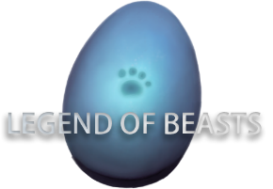
www.hbeasts.com
Legend Of Beasts
A new metaverse concept integrates casual, social, and Play-To-Earn NFT Game
Notes:
神兽传是一款集休闲、社交一体MMORPG的Play-to-earn游戏。

Slide 2

Metaverse Market size
www.hbeasts.com
Total market size
800 billion
120 million
Expected to gain market share in 1~2 years
30 million
1 year after financing
Expected receivable
Notes:
市场的总规模（假设没有竞争） 未来获得的市场份额 假如成功融资

Slide 3
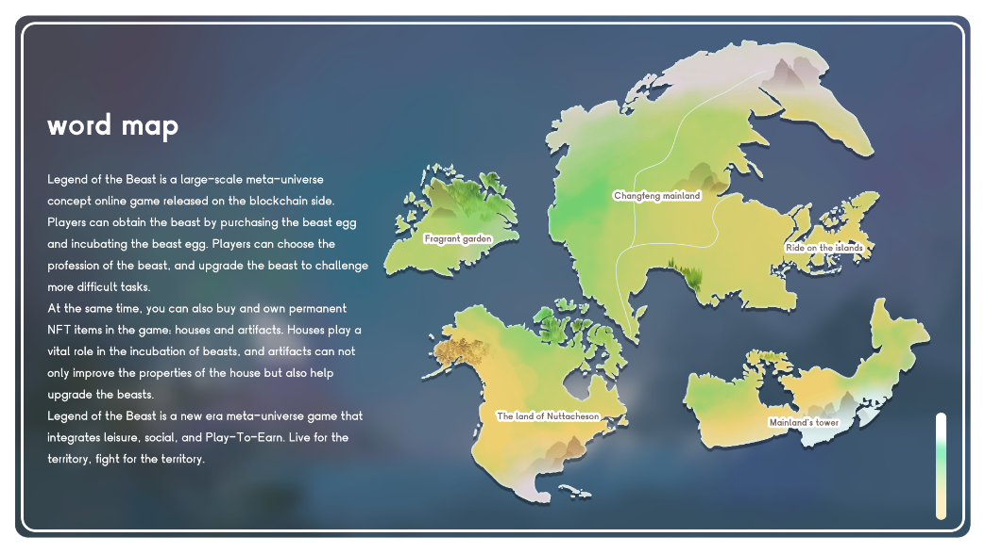
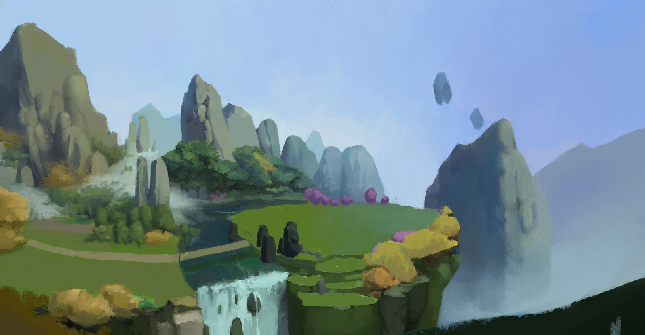
Game content
www.hbeasts.com
Legend of the Beast is a large-scale metaverse concept online game released on the blockchain side. Players can obtain the beast by purchasing the beast egg and incubating the beast egg. Players can choose the profession of the beast, and upgrade the beast to challenge more difficult tasks.
At the same time, players can also buy and own permanent NFT items in the game: houses and artifacts. Houses play a vital role in the incubation of beasts, and artifacts not only improve the properties of the house but also help upgrade the beasts.
Legend of the Beast is a new metaverse game which integrates casual, social, and Play-To-Earn. Live for the territory, fight for the territory
Notes:
市场的总规模（假设没有竞争） 未来获得的市场份额 假如成功融资

Slide 4
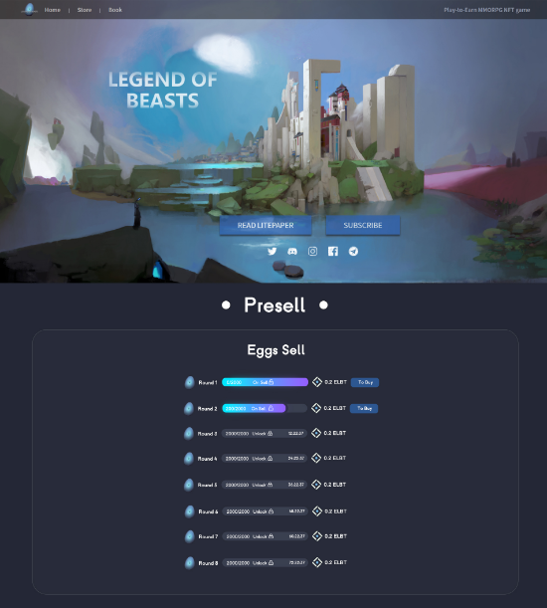
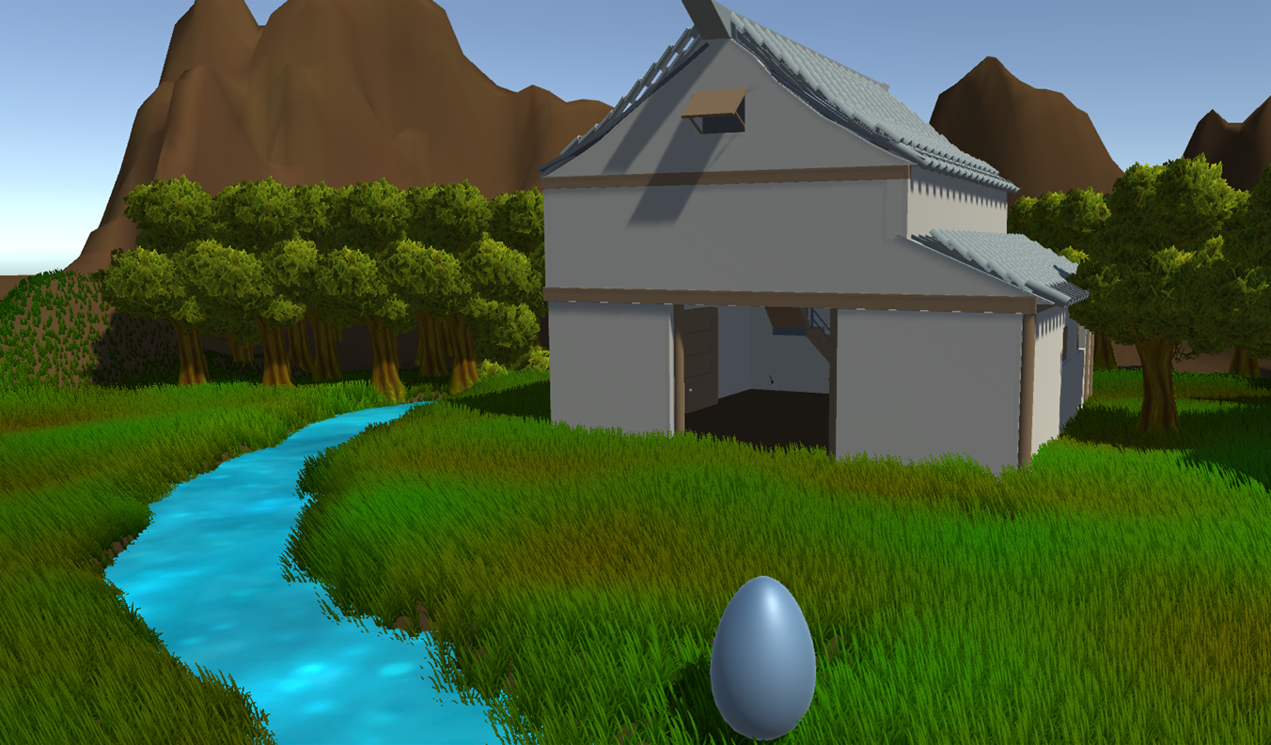
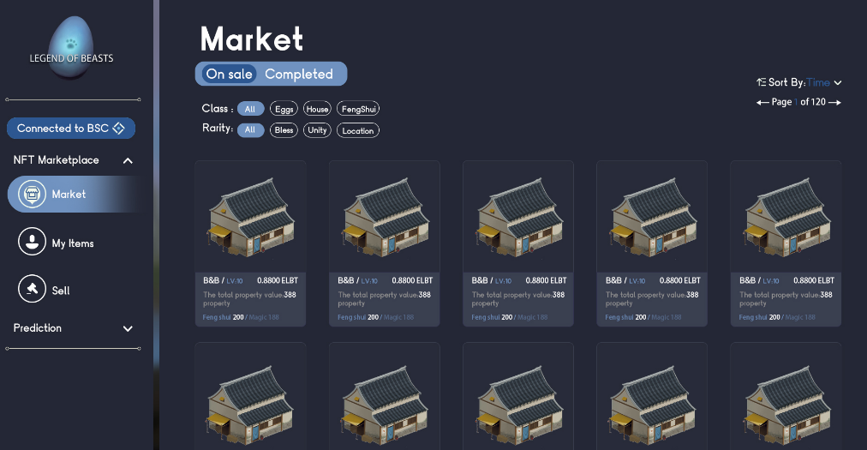
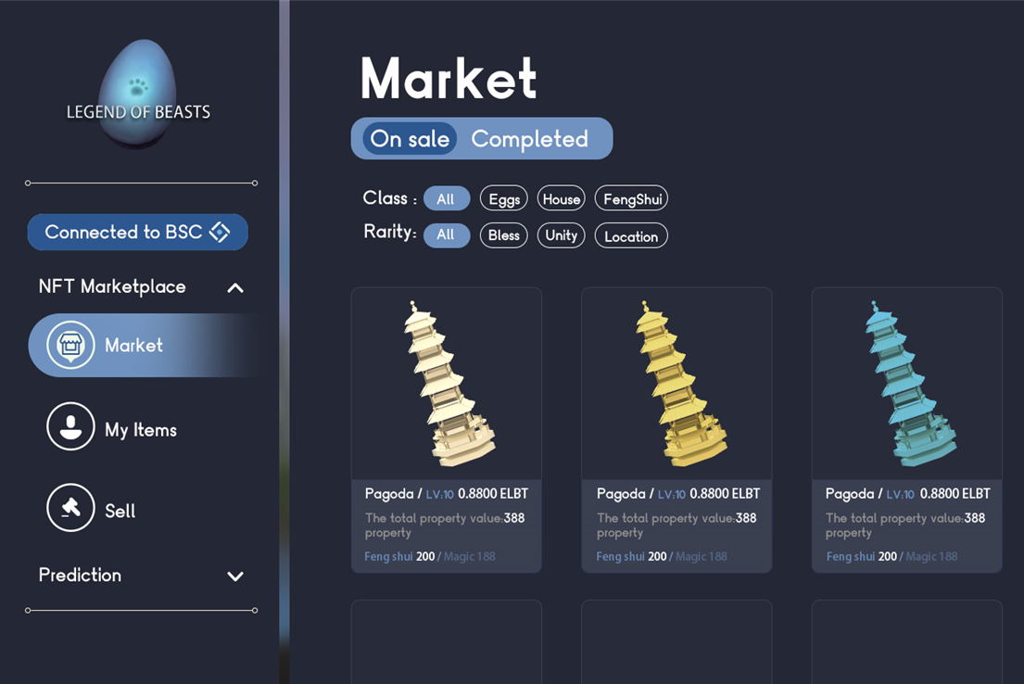
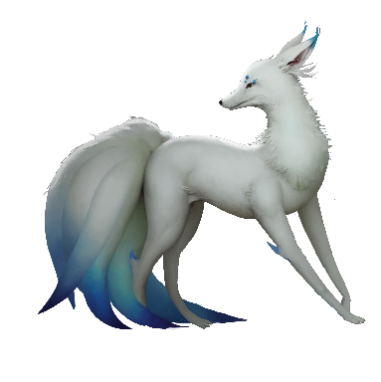
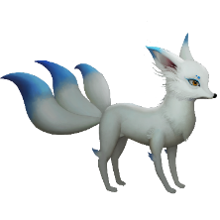
1 Prepare the beast eggs
2 Play games & make friends
3 Trading market
When you are more mature, you can perform advanced tasks and meet other friends
I'm going to perform some tasks
Notes:
市场的总规模（假设没有竞争） 未来获得的市场份额 假如成功融资

Slide 5




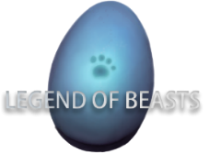









Competitor
www.hbeasts.com
Iterable
Metaverse
Notes:
市场的总规模（假设没有竞争） 未来获得的市场份额 假如成功融资

Slide 6
Operation Plan
www.hbeasts.com
2w
Online：1200000 U
1w
Public-Sale: 600000 U
2k
Pre-Sale NFT: 100000 U
REGISTERED USER
BUSINESS
Notes:
市场的总规模（假设没有竞争） 未来获得的市场份额 假如成功融资

Slide 7
TOKENOMICS
www.hbeasts.com
Legend of beasts Token: $LOB. Total Supply: 300,000,00
Type | number
Public Sale | 5,400,000
Team and Advisor | 3,000,000
Community | 3,000,000
In Game | 6,900,000
Reserve | 3,300,000
Ecosystem | 6,000,000
User | 2,400,000
Total | 30,000,000
User
8%
Ecosystem
20%
Community
10%

Slide 8
ROAD MAP
www.hbeasts.com
2021.9 concept
2022.11 Ready
2022.1 Pre-sale
Build the Team
Social media build
Game world design
Casual social attributes
Official website
Online White paper release
Novel story release
Game Demo
Cooperative agency
Number of 2000 users
Game Map online
Number of 5000 user
NFT Marketing online
Sample Room Demo
Multiplayer interaction
2022.3 Launch
2022.5 maintenance
Game asset system online
Career system online
NFT Mortgage lease and sale function
Number of 15000 users
Content operation
Life cycle management
Ready for the PVP stage
Notes:
市场的总规模（假设没有竞争） 未来获得的市场份额 假如成功融资

Slide 9
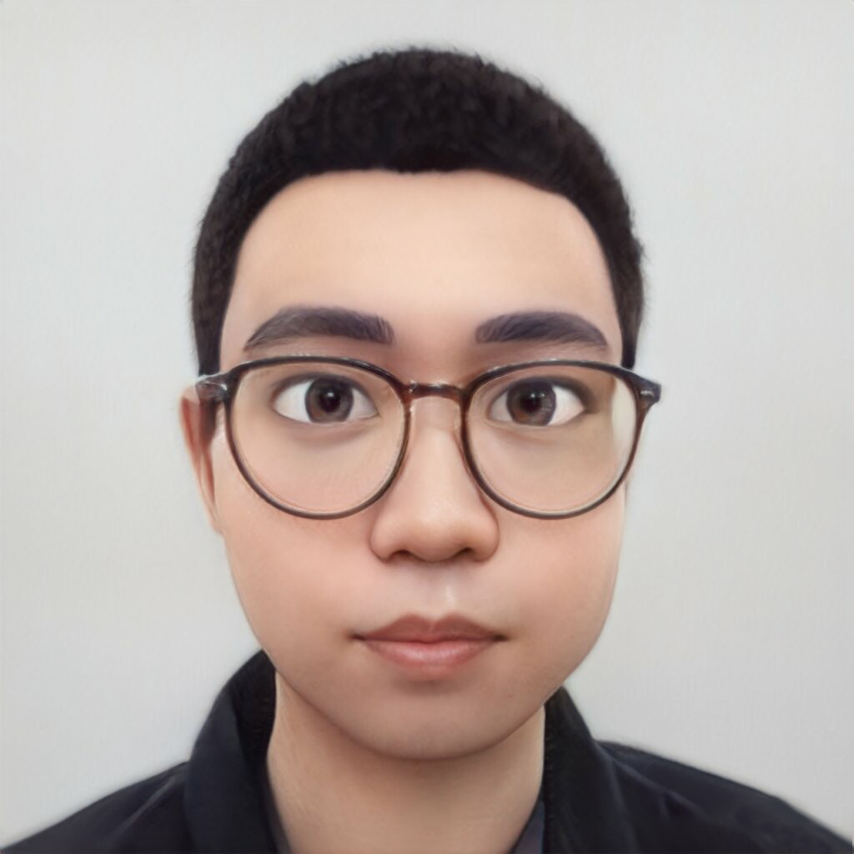
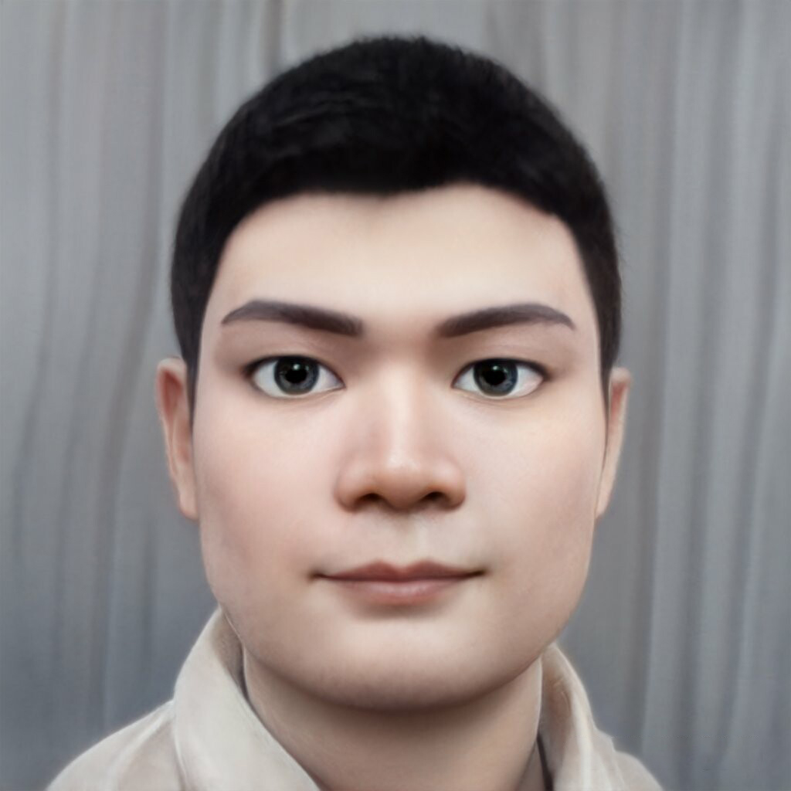
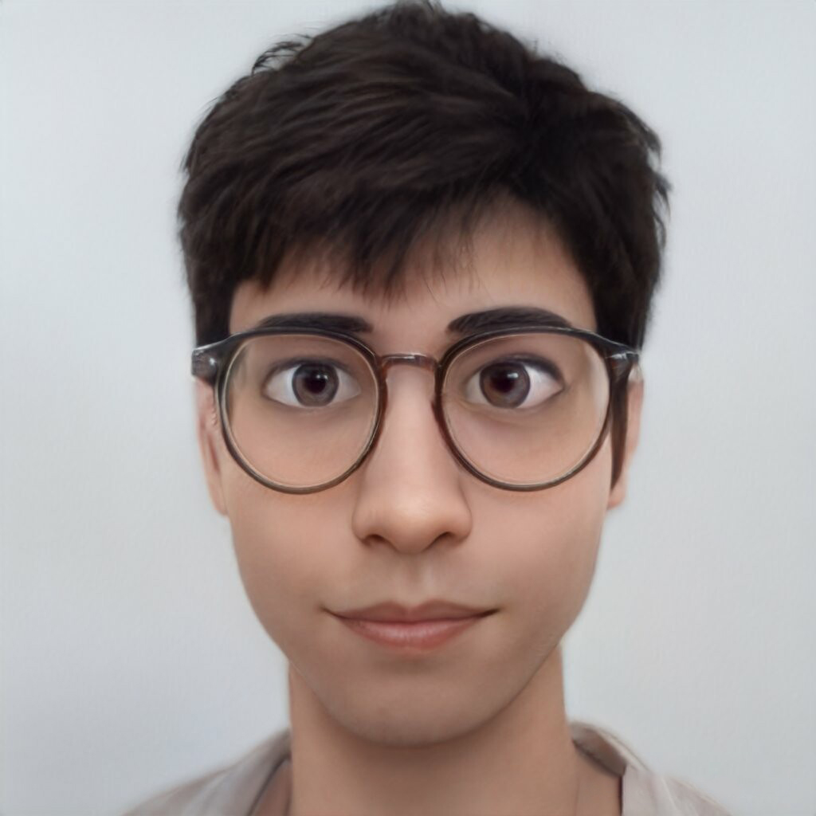

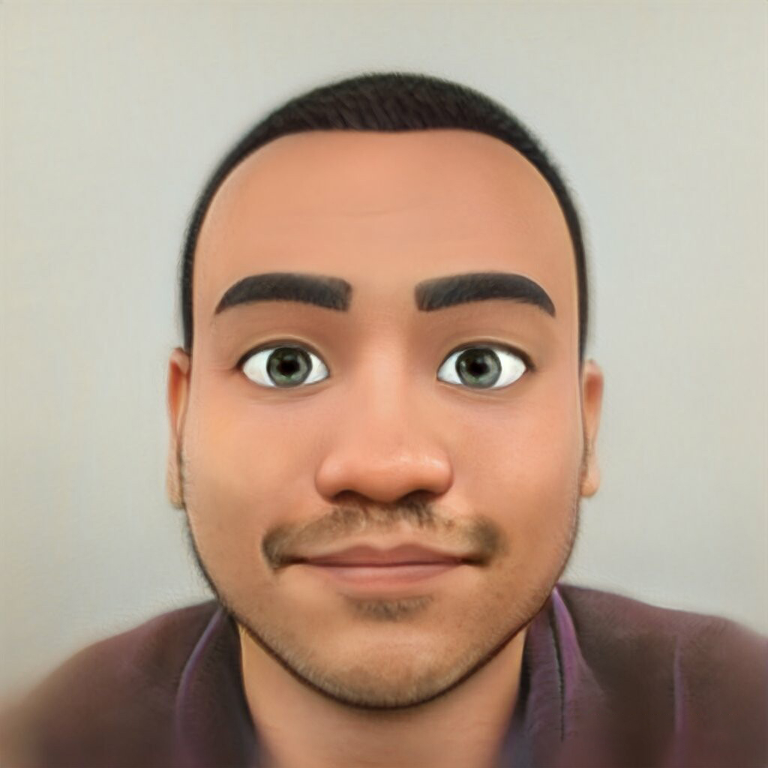
Team
www.hbeasts.com
Feng Cheng
Frank
Jack
Former Huawei manager have 5 years global working Experience, with rich project experience in the field of software development and product management.
Deep understanding of financial regulations and cryptocurrencies, have professional user scene In the game field
Former gameloft game planner, good at realistic character depiction and detailed control, able to guide any style of game
CEO
COO
Visual director
Shreyas Vasuki
Roll
with rich programming skills and problem-solving skills, familiar with blockchain application development.
has more than 4 years of working experience in cryptocurrency exchanges, have unique brand version and market experience.
CTO
CMO
Notes:
市场的总规模（假设没有竞争） 未来获得的市场份额 假如成功融资

Slide 10
www.hbeasts.com
Q&A
If Have question, contact us
chongchongtech@gmail.com
Notes:
神兽传是一款集休闲、社交一体MMORPG的Play-to-earn游戏。

